Slide 1
Python + HTML + Localhost
How I can implement
the research paper
IoT Devices
make data
Local
Learning
A simple localhost demo for Collaborative IoT Intrusion Detection
Attack
Alert
Main idea: many small devices learn together, but raw data stays local.
This is a classroom-friendly prototype, not a full real IoT hardware deployment.

Slide 2
What the paper idea becomes in my project
I will turn the paper concepts into a small working website on my computer.
Paper idea
IoT devices can be weak and easy to attack.
My code idea
Make virtual IoT devices using Python.
Paper idea
IDS watches traffic and finds strange behaviour.
My code idea
Python model predicts Normal or Attack.
Paper idea
Federated Learning keeps raw data local.
My code idea
Each device trains locally; server averages updates.
Result: a safe simulation that shows the research idea clearly.
Based on the review paper: Collaborative IDS in resource-constrained IoT environments

Slide 3
Full localhost workflow
Everything runs on one computer using Python and browser pages.
1
Virtual
IoT Devices
2
Generate
Data
3
Local
Training
4
FedAvg
Server
5
HTML
Dashboard
Normal traffic
+
Safe attack traffic
Model update only
Raw data not shared
Browser shows
devices, alerts, accuracy
Based on the review paper: Collaborative IDS in resource-constrained IoT environments

Slide 4
Whole code map
Each file has one simple job, like students in a group project.
app.py
Starts Flask and opens localhost pages.
federated_server.py
Combines local models using FedAvg.
device_simulator.py
Makes fake IoT device data.
detector.py
Checks if new data is Normal or Attack.
attack_simulator.py
Creates safe attack-like data.
database.py
Saves logs, alerts and results.
local_training.py
Trains one small model per device.
templates/*.html
Shows everything in the browser.
Easy sentence: “My project separates the paper idea into small Python files and HTML pages.”
Based on the review paper: Collaborative IDS in resource-constrained IoT environments

Slide 5
Code Step 1 — Make virtual IoT devices
No hardware is needed. Python pretends that devices are sending data.
device = "Smart Camera 1"
packets_per_sec = random number
packet_size = random number
failed_connections = random number
save row in device_1.csv
What this code means:
• A device is like a small smart object.
• It makes numbers that look like network activity.
• These numbers become the dataset.
• The data stays inside that device file.
device, packets, size, failed, label
camera_1, 40, 512, 1, normal
label = answer
normal or attack
Example data row
Based on the review paper: Collaborative IDS in resource-constrained IoT environments

Slide 6
Code Step 2 — Create safe attacks and detect them
The project does not attack any real website or real device. It only creates test numbers.
Normal example
Attack-like example
detector.py
packets_per_sec = 35
failed_connections = 0
label = normal
packets_per_sec = 9000
failed_connections = 450
label = attack
prediction = model.predict(data)
if prediction == attack:
show red alert
If the device suddenly sends too much traffic, the model marks it as suspicious and the website shows an alert.
Simple meaning:
Based on the review paper: Collaborative IDS in resource-constrained IoT environments

Slide 7
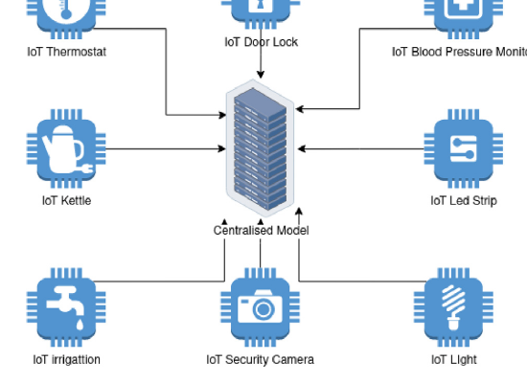
Code Step 3 — Federated Learning in simple words
Each device learns from its own data. The server only combines the learning.
for each device:
local_model = train(device_data)
send local_model weights
global_model = average(all_weights)
Why this matches the paper
• Data stays with the device.
• Only learning updates are shared.
• The global model improves slowly.
• This is called FedAvg.
Paper figure idea: devices send model updates to a central server
Easy example: 3 students solve a small part, then the teacher combines their answers.
Based on the review paper: Collaborative IDS in resource-constrained IoT environments

Slide 8
Code Step 4 — Show everything on localhost
Flask connects Python code with HTML pages in the browser.
app.py
Browser pages
What the user sees
app = Flask(__name__)
@app.route("/")
def home():
return render_template("index.html")
app.run(debug=True)
Home page
Devices page
Attack simulator page
Training page
Detection page
Results page
localhost:5000
Devices online: 3
Current alert: DoS-like
Accuracy: 94%
Raw data shared: No
Simple meaning: Python does the work, HTML shows the result.
Based on the review paper: Collaborative IDS in resource-constrained IoT environments

Slide 9
Demo path during presentation
This is the order I can show to my teacher.
1
Run project
python app.py
2
Open browser
localhost:5000
3
Generate data
normal + attack rows
4
Train locally
each device learns
5
Average updates
FedAvg creates global model
6
Show alerts
Normal or Attack appears
Final message: “This localhost system demonstrates the paper’s idea using safe simulated IoT data.”
Based on the review paper: Collaborative IDS in resource-constrained IoT environments

Slide 10
What I can honestly claim
This slide protects you during viva/presentation.
Implemented / shown in localhost
Not fully implemented
• Virtual IoT devices
• Normal and attack-like data
• Local training per device
• Federated averaging idea
• Normal/Attack prediction
• Dashboard with alerts and results
• Real microcontroller deployment
• Real battery/power testing
• Real Wi-Fi/Bluetooth attack testing
• Real hospital/factory IoT network
• Full cybersecurity production system
Best project title: “A localhost-based educational prototype of Collaborative IoT Intrusion Detection using Federated Learning.”
Based on the review paper: Collaborative IDS in resource-constrained IoT environments

Slide 11
Short speech for this implementation slide
You can say this in class in simple English.
“This research paper is mainly about collaborative intrusion detection for IoT devices. I implemented the idea as a localhost prototype. In my project, Python creates virtual IoT devices and generates normal and attack-like traffic. Each device keeps its own data and trains a small local model. Then the federated server combines the local model updates using Federated Averaging. Finally, Flask and HTML show the devices, training status, predictions, and attack alerts in the browser. So my project does not fully deploy on real hardware, but it clearly demonstrates the main research idea in a safe and understandable way.”
Remember: say “prototype” or “simulation”, not “full real-world system”.
Based on the review paper: Collaborative IDS in resource-constrained IoT environments

Slide 12
Final implementation summary
One picture of the whole project.
Research Paper
Concepts
Python
Simulation
Federated
Learning
Localhost
Dashboard
Codes used:
app.py • device_simulator.py • attack_simulator.py • local_training.py
federated_server.py • detector.py • database.py • HTML templates
Thank you
Based on the review paper: Collaborative IDS in resource-constrained IoT environments

